Slide 1
Improving the Google Merchandise Store
Module 10 Challenge

Slide 2
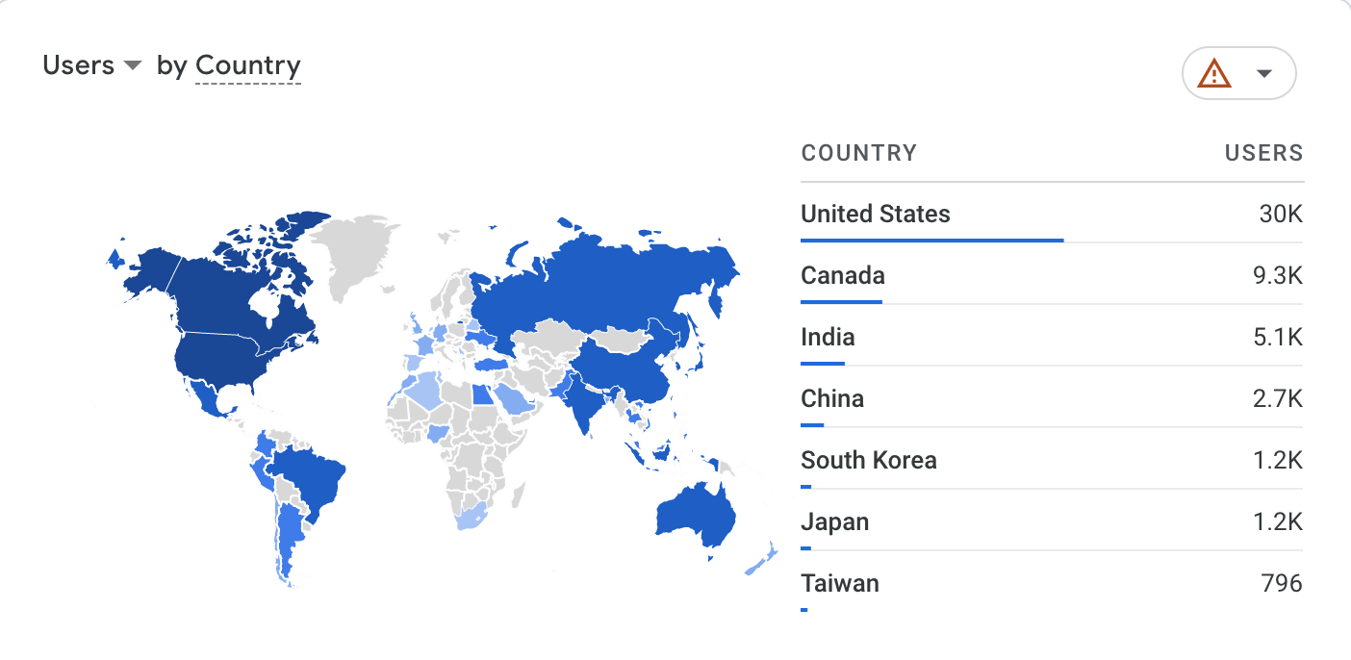
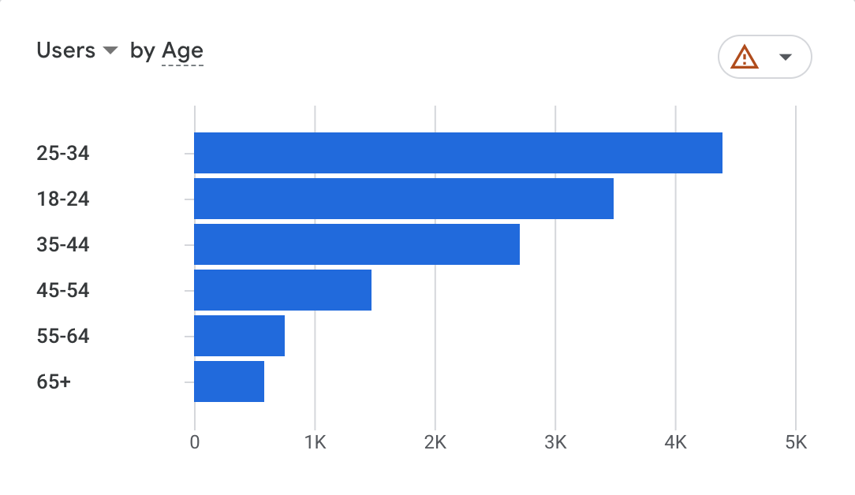
Who are the current Google Merchandise Store users?
Most of the users come from USA, Canada and India between ages of 25-34, followed by 18-24 & 35-44 yo

Slide 3
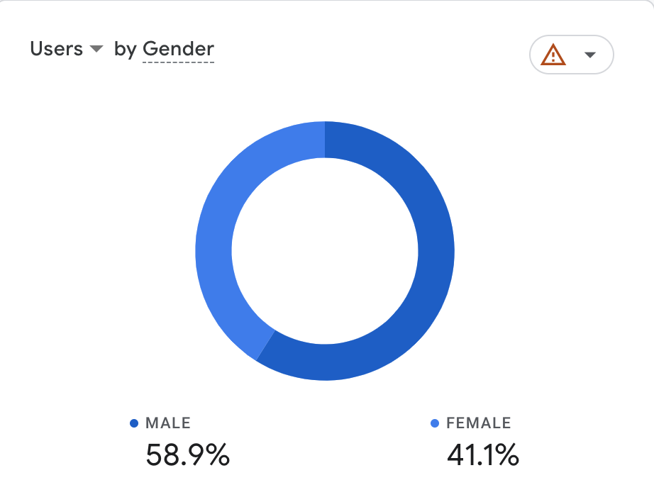
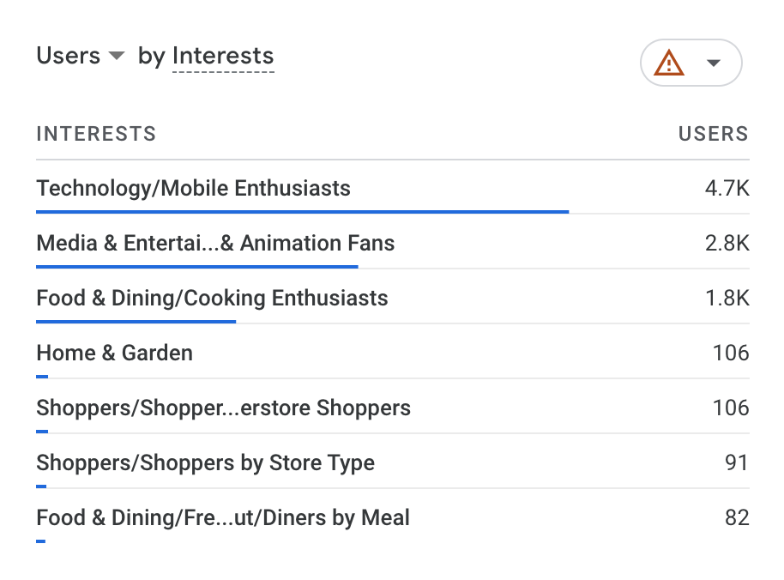
Who are the current Google Merchandise Store users?
There is a slightly higher number of male users of 58.9% and 41.1% of female users. Majority of our users exhibit interests in Technology/Mobile of 4.7K

Slide 4
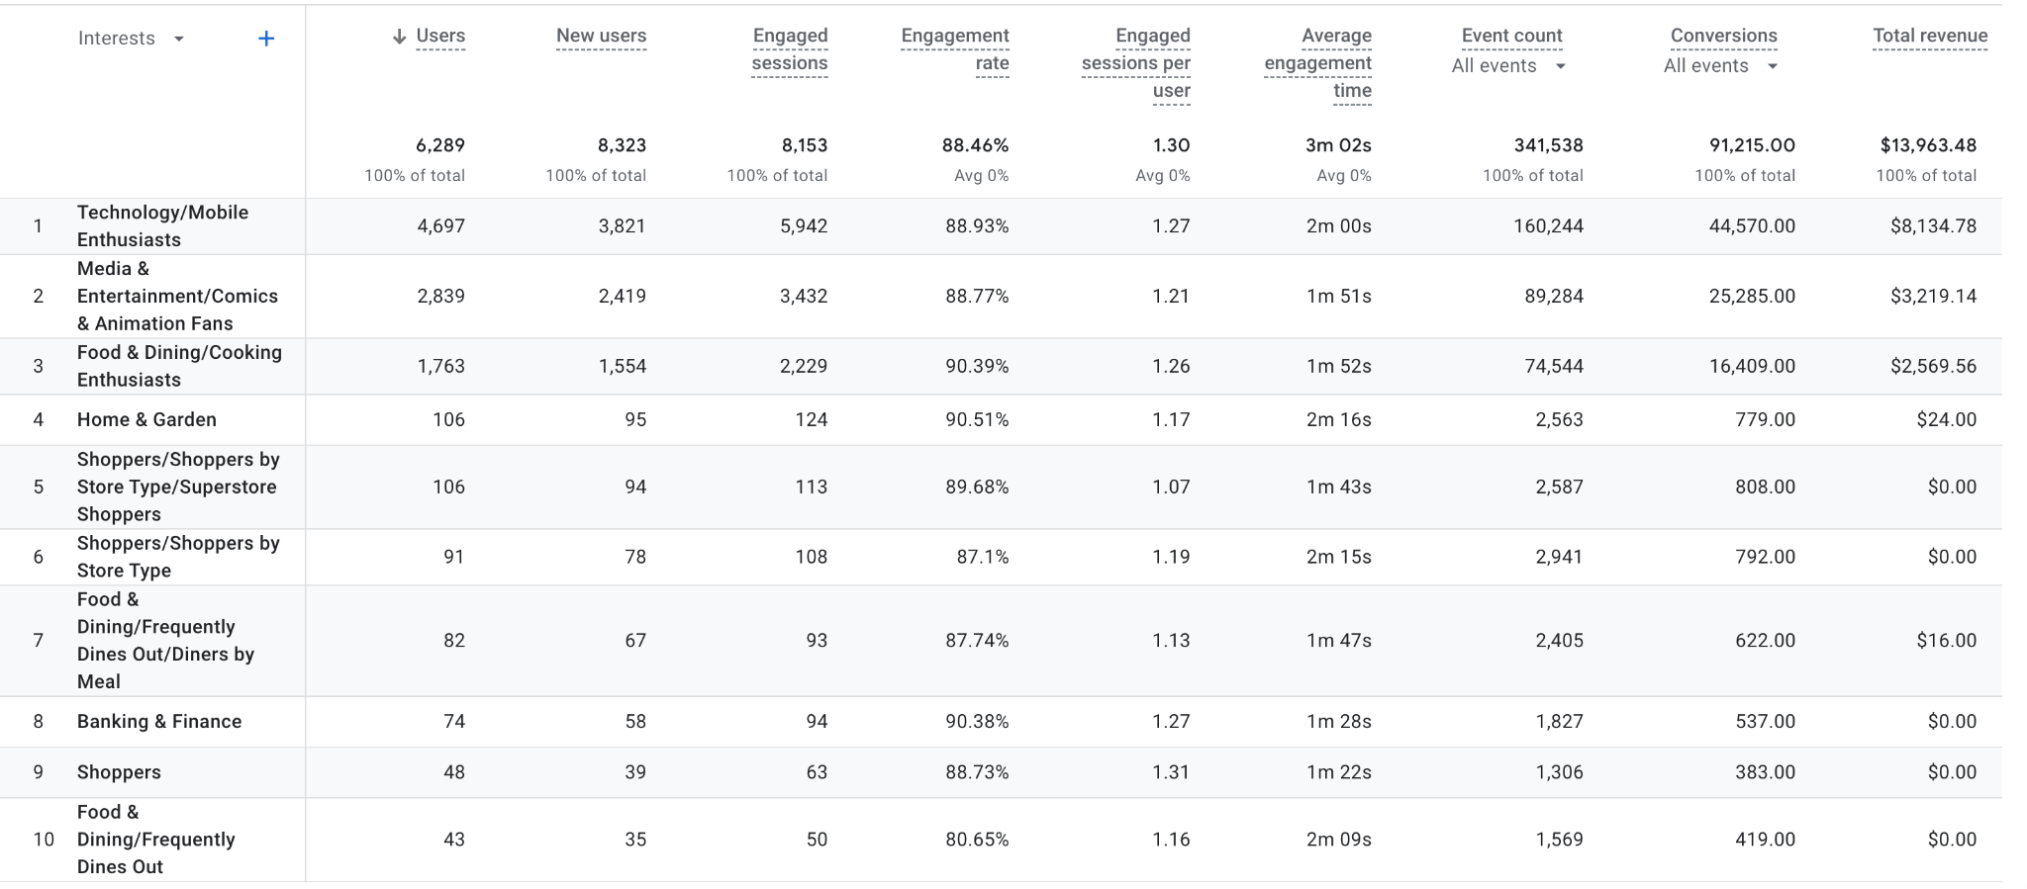
What behaviors do shoppers exhibit on the site?
Insights -
Technology & Mobile Enthusiasts has the highest number of new users (5,942) and the highest total revenue of $8K
Technology & Mobile Enthusiasts also has the highest event count (160K) , which explains why there is a high number of engagement and new users
The highest engagement rate is seen of users with the Home & Garden Interest of 90.51% and highest avg engagement time of 2m 16s.

Slide 5
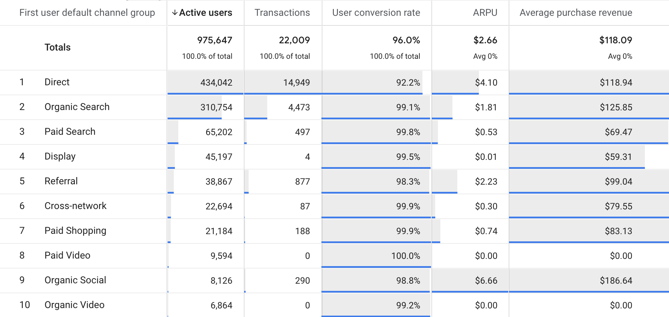
What behaviors do shoppers exhibit on the site?
Insights -
Direct channel exhibits the Highest number of active users (434K), transactions (15K), but second highest Average Revenue per User ($4.10)
Highest Average Purchase Revenue is seen with Organic Social of $186.64 and highest ARPU of $6.66
User conversion rate is the highest through Paid Video (100%), Paid Shopping (99.9%), Cross-network (99.9%) and Paid Search (99.8%)
Notes:
What behaviors do shoppers exhibit on the site? Some metrics to examine:
Conversion rate
Revenue per user
Average order value
Other key metrics that measure site usability

Slide 6
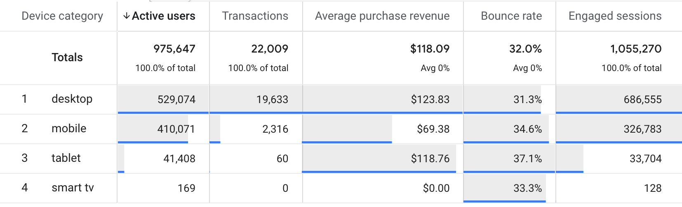
What behaviors do shoppers exhibit on the site?
Insights -
Desktop represents highest number of active users (529K) and transactions (19K) as well as APR of $123.83
The highest bounce rate of 37% is seen by the users who use tablet. However the tablet scored second highest APR of $118.76 with very little transactions and engaged sessions

Slide 7
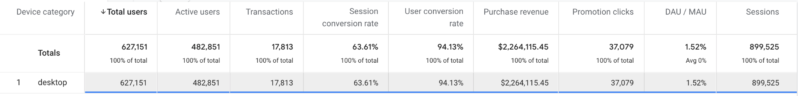
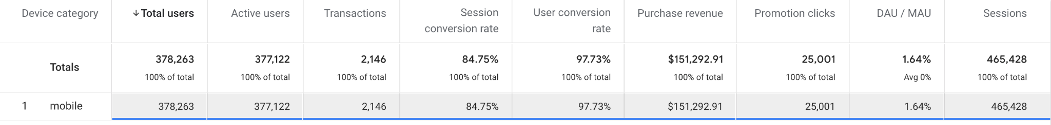
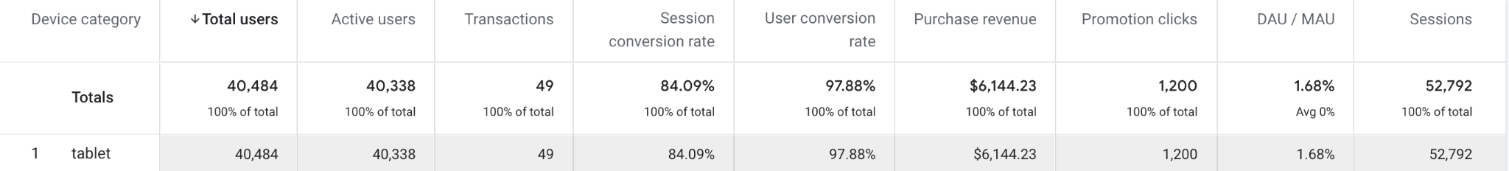
Are there different user segments that behave differently on the site?
If so, what are the key segments to examine for these segments? How do they differ?
Desktop
The different segments to analyze are the device categories - Desktop, Mobile, and Tablet. These segments can show us the different ways our users are accessing the ecommerce store.
Insights -
Desktop exhibits to be the leader in most of the metrics including total users, active users, promotion clicks, purchase revenue. However, the lowest in session conversion rate and user conversion rate in comparison to Mobile and Tablet categories. Desktop also has the lower DAU/MAU ratio of 1.52%
Highest user conversion rate is seen at Tablet with 97.88% followed by Mobile 97.73%. Mobile has the highest session conversion rate of 84.75%. Tablet shows conversion issues.
Mobile
Tablet

Slide 8
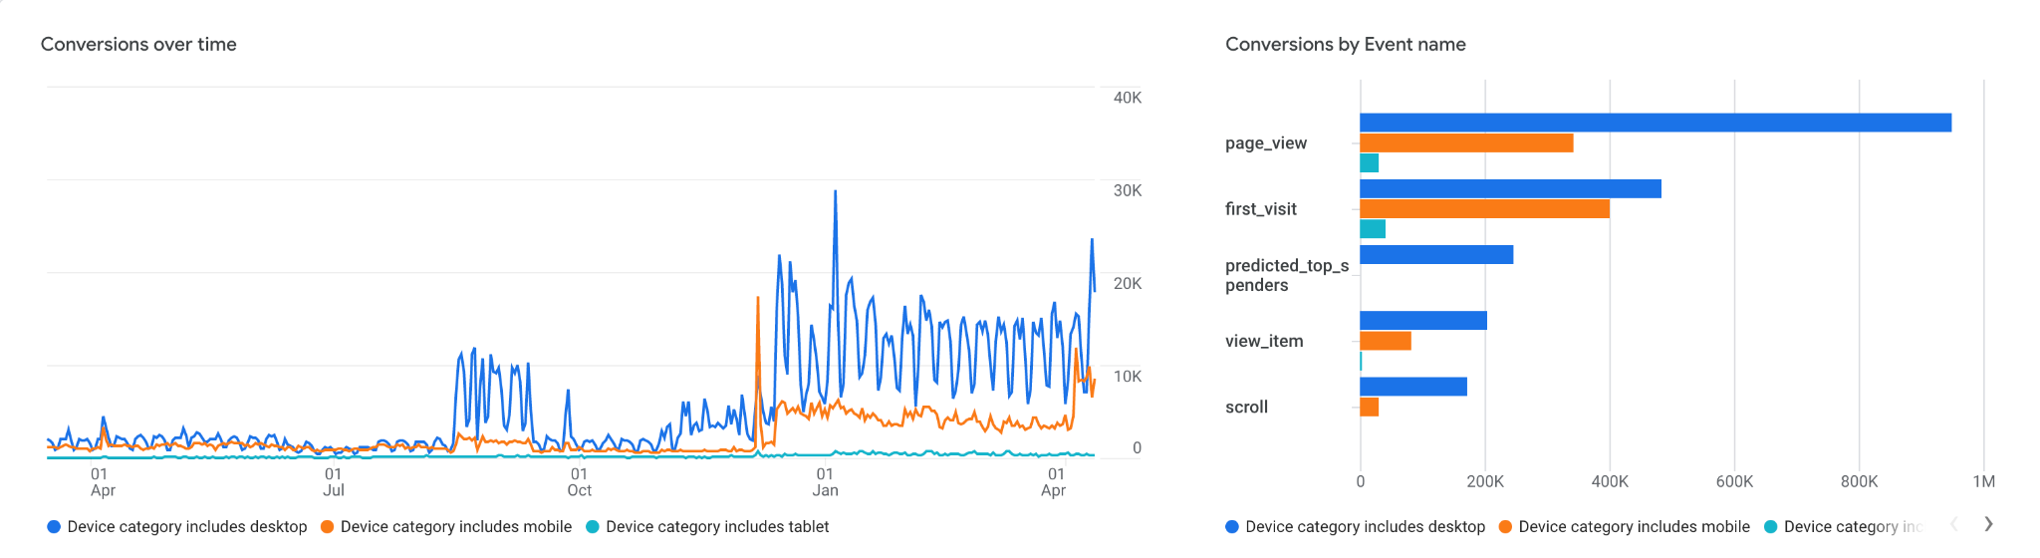
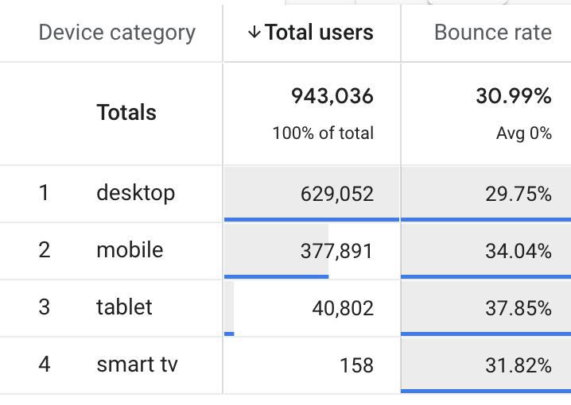
How have users and their behaviors changed over time?
Where do conversion issues exist?
Insights - Throughout the year, the users behavior on different device categories changes over time. It usually peaks around August then slows down again before it peaks in Dec, Jan, and Feb. Users show to first visit the site via mobile and desktop while tablet shows very little visits. Conversion Issues exist in Mobile and Tablet. Bounce Rate is the highest in Tablet followed by mobile.

Slide 9
What KPIs do you recommend tracking to measure and assess the health of the website in the future? You could also consider setting OKRs based on your findings.
Recommended KPIs-
Conversion Rate
Mobile Conversion Rate
Bounce Rate
Session Duration
Pages Per Session
Recommended OKRs-
Increase Mobile Conversion Rate
Objective: To improve the conversion rate for users who access the site from mobile and tablet devices.
Key Result: Increase the mobile conversion rate by X% over the next Y months.
Reduce Bounce Rate
Objective: To improve the engagement of visitors with the site's content.
Key Result: Reduce the bounce rate by X% over the next Y months.
Increase Session Duration
Objective: To improve the engagement of visitors with the site's content.
Key Result: Increase the average session duration by X seconds over the next Y months.

Slide 10
What website changes could you make to improve the user shopping experience?
There are several changes you could make to improve the user shopping experience on your e-commerce site:
Mobile optimization
Personalization
Streamlining Checkout Process
Optimizing Product Pages

Slide 11
Reflection Paper: What additional data do you wish you had?
Reflection Paper: What was the most challenging part of the analysis to complete? Why?
It would have been helpful to have user feedback information. Qualitative data from surveys, customer reviews, and social media comments could help to supplement the quantitative data in Google Analytics and provide a deeper understanding of the user experience.
The most challenging part is looking at the bigger picture and not getting lost in all the numbers and metrics. GA presents so many numbers and metrics. At times it was hard to wrap my head around what metric to look at and what kind of story does that metric tell us.

Slide 12
Reflection Paper: What other research or analysis would you want to supplement your findings?
To supplement the findings from this analysis, additional research or analysis could include:
A/B testing: Running A/B tests to experiment with different website changes could help to validate the insights and recommendations made in the analysis.
User testing: Conducting user testing with a sample of site visitors could provide qualitative data about the user experience and help to identify areas for improvement.
Competitor analysis: Comparing the site's metrics and user experience to those of its competitors could provide additional context and help to identify opportunities for differentiation.

Slide 13
Reflection Paper: What was the most interesting insight you uncovered?
Reflection Paper: How might you use this kind of analysis in your product management career?
The most interesting insight from the analysis could be the finding that the site has conversion issues with users who use mobile and tablet devices. This highlights the importance of optimizing the site for these devices and provides a specific area for improvement.
In a product management career, this kind of analysis can be used to make data-driven decisions about product design, development, and marketing. By regularly tracking key performance indicators and user behavior, product managers can identify areas for improvement, prioritize development work, and measure the impact of changes over time. This can help to ensure that products are delivering value to users and meeting the needs of the business.

Slide 14
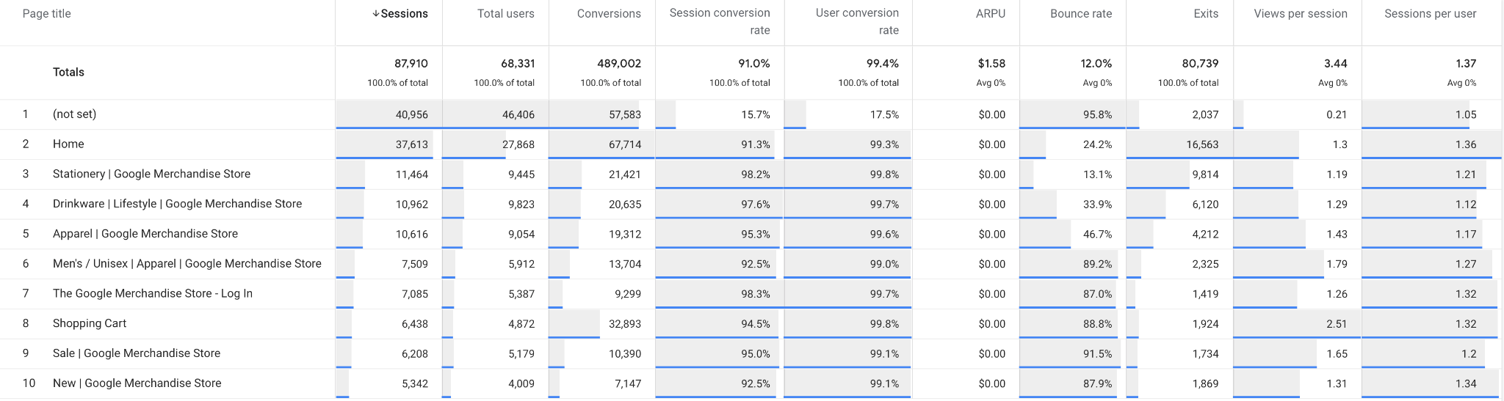
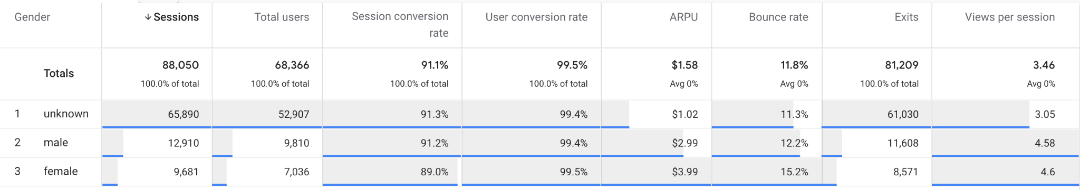
What behaviors do shoppers exhibit on the site?

